Slide 1

YELP DATA Challenge
Shiqing Chen,
Jahnavi Nadipi,
Wenliang Sun,
Jiaru Zhu

Slide 2
START
Start with an EXAMPLE

Slide 3
Step 1
Q: In what CITY
do you open your restaurant?
A: New York

Slide 4
I am the Machine
Umm…
New York!
Let me find the city that is the Most Similar to New York!

Slide 5
I am the FUNCTION
By similarity,
I mean K-MEANS!
and.. Two Approaches

Slide 6
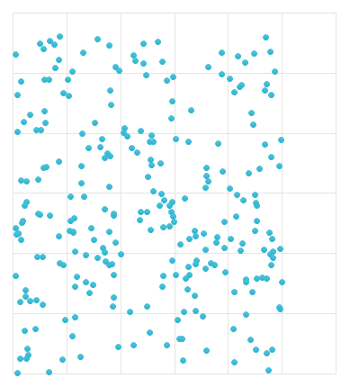
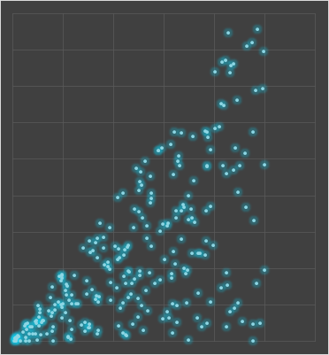
I am the FUNCTION
City Data
Yelp Data

Slide 7
Then I run K-MEANS…
I am the FUNCTION
LA
New York
Chicago
LA
New York
Philadelphia

Slide 8


I am the Machine
Ok! Now I know it’s LA Because K-MEAN shows same cluster with minimum distance

Slide 9
Step 2
Q: What type of Restaurant?
A: Korean, BBQ , $$$……

Slide 10
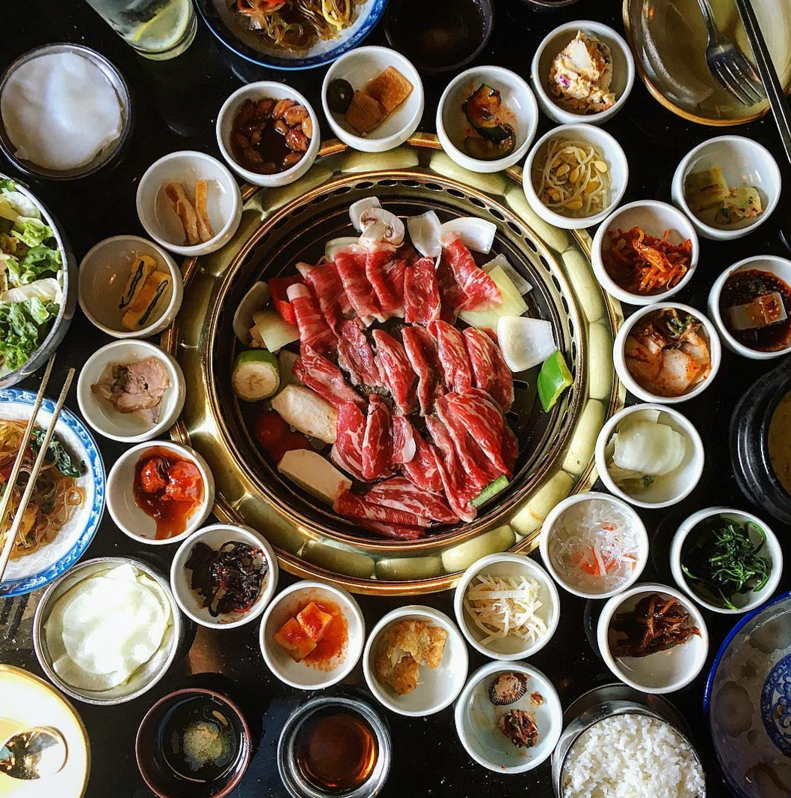
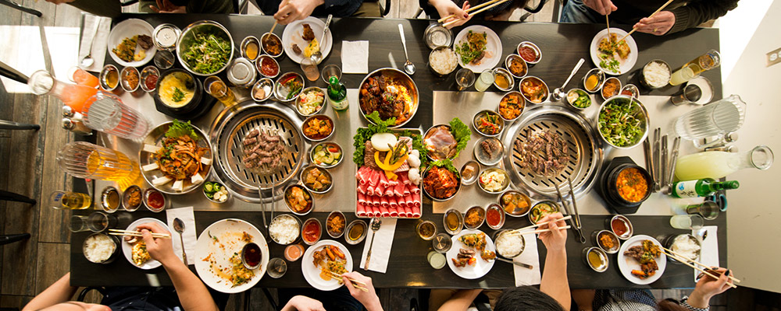
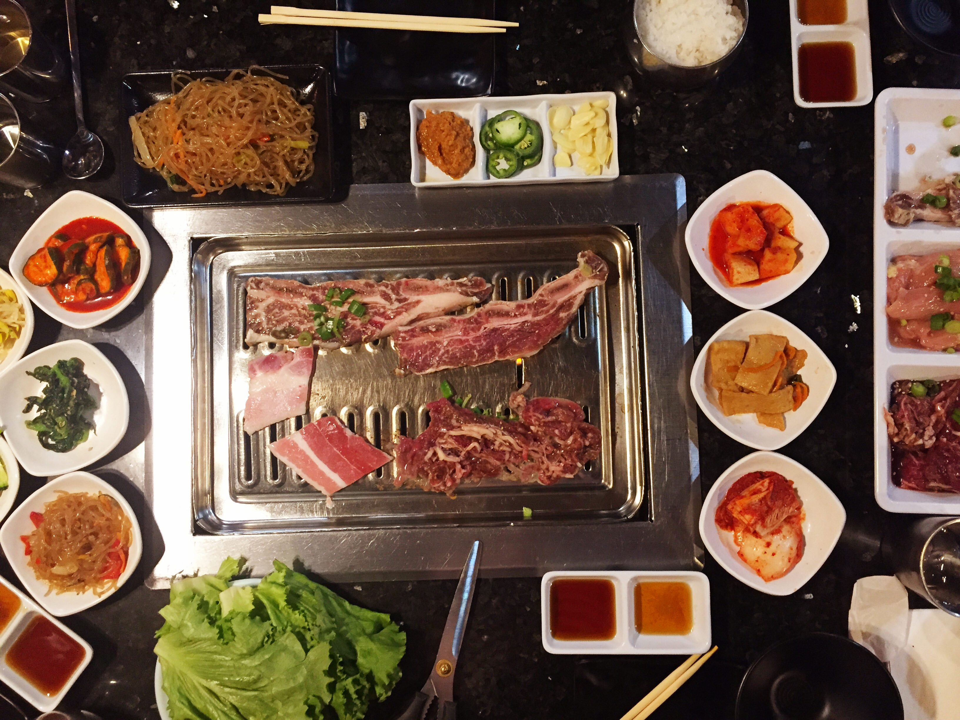
I am the Machine
Ok! Now let me find KOREAN -> BBQ -> … -> ->
restaurants from LA (WHY?)

Slide 11
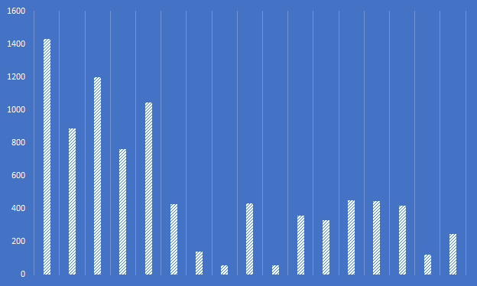
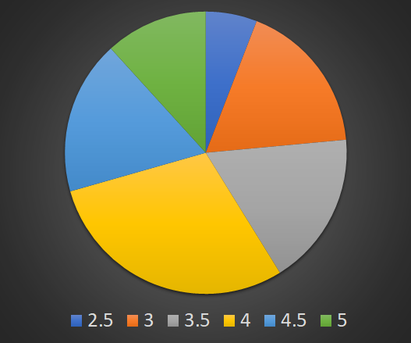
I am the Machine
Found 17 Restaurants!
Average review: 519
Average rating: 3.65

Slide 12
I do filtering on the 17 restaurants via SVM!
Dimensionality:
Average Meal Cost
Business size
Daily Visitors
I am the FUNCTION

Slide 13
The SVM for Average Meal Cost
I am the FUNCTION

Slide 14
I combine the results from three
SVM with user input.
I am the FUNCTION
$
Class 2
SVM 1
size
Class 1
SVM 2
other
Class 1
SVM 3
Then, I find the commons ones:
{Class2}_{svm1} ∩ {Class1}_{svm2} ∩ {Class1}_{svm3}

Slide 15
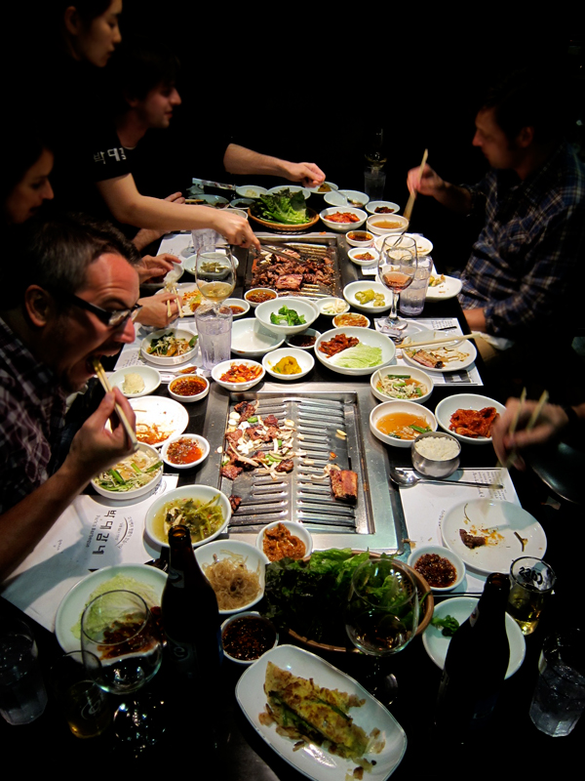
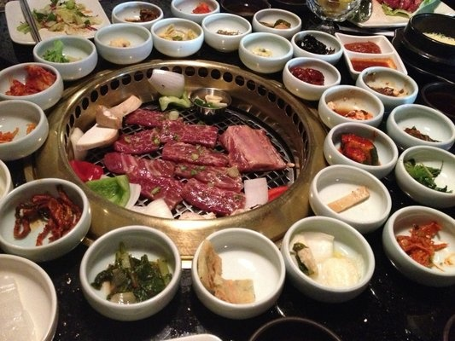
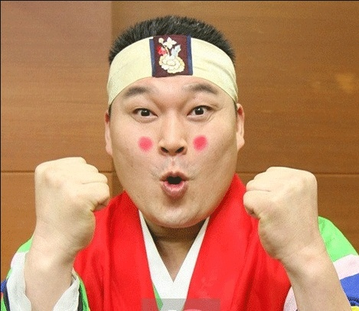

I am the Machine
Yes! The function returns the results!
Three restaurants!
Park’s BBQ
Genwa Korean BBQ
Kang Ho Dong Baekjeong
1185
726
1428

Slide 16
I am the Machine
Yes! The function returns the results!
Three restaurants!
Park’s BBQ
Genwa Korean BBQ
Kang Ho Dong Baekjeong
Average Star: ~4
Average Reviews: 1113

Slide 17
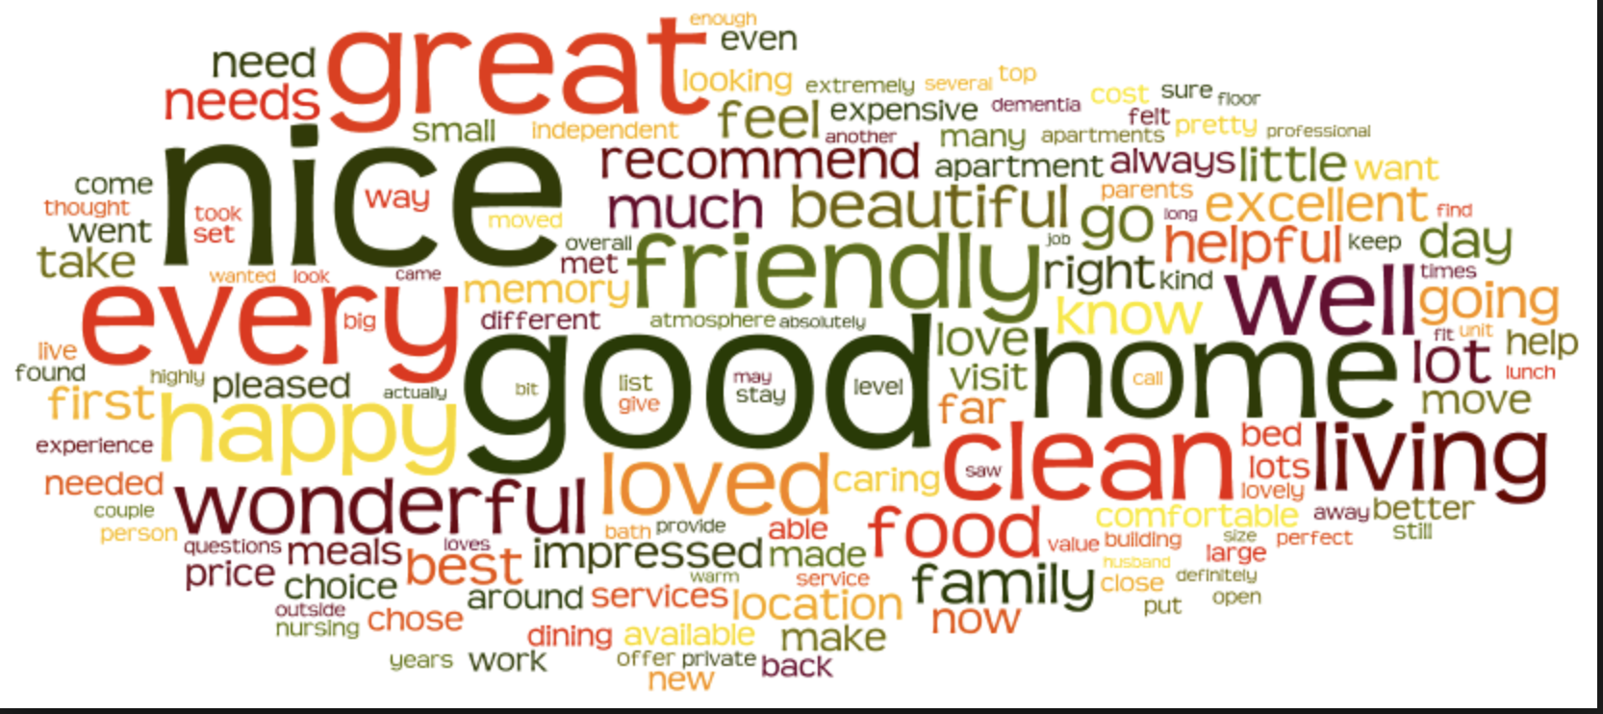
Step 3
Q: Define Features?
Review Text Mining Results of FIVE STAR

Slide 18
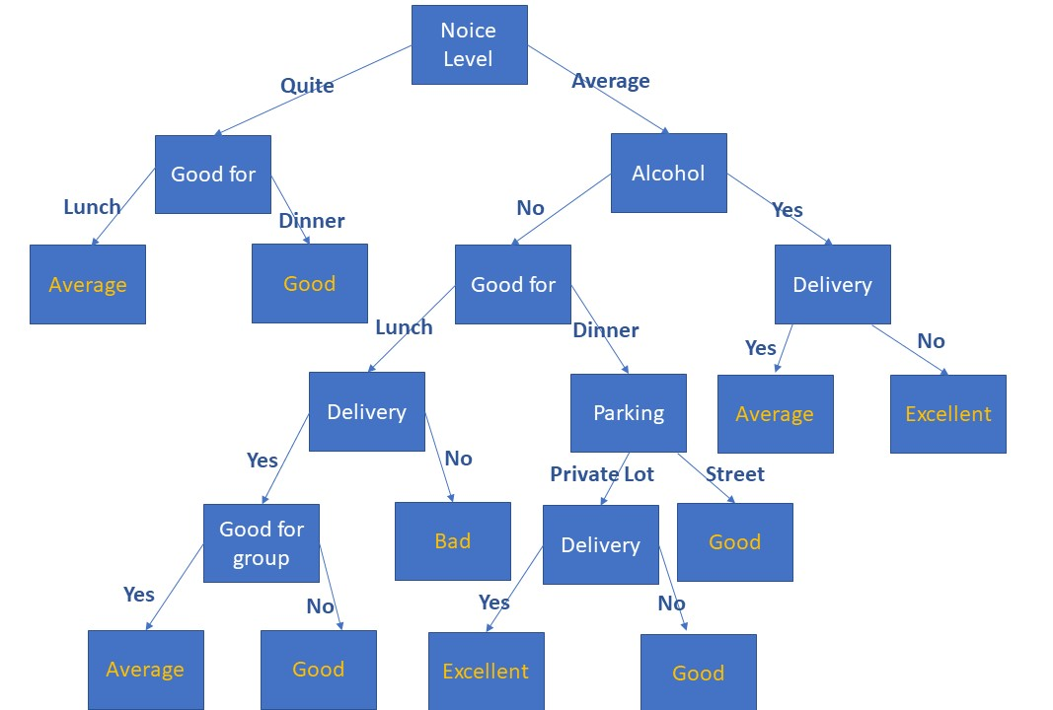
I am the Machine
Run Pre-trained Decision Trees

Slide 19
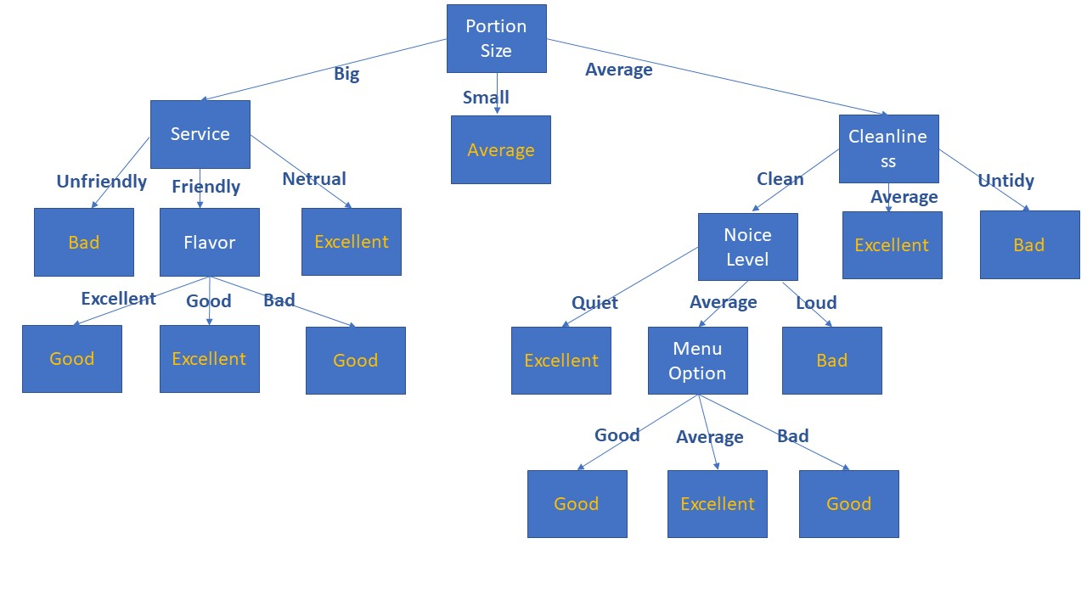
I am the Machine
Run Pre-trained Decision Trees

Slide 20
I am the Machine
Key Features with rank and score
Attribute | Influence Rank | Score
Noise | 1 | 100
Delivery | 2 | 94
Good for group | 3 | 89
Portion size | 4 | 83
service | 5 | 78
Cleanliness | 6 | 72
Wi-fi | 7 | 67
Price | 8 | 61
TV | 9 | 56
Parking | 10 | 50
Quality | 11 | 44
Ambience | 12 | 39
Reservation | 13 | 33
Outdoor seating | 14 | 28
Menu | 15 | 22
Location | 16 | 17
Flavor | 17 | 11
Accept credit card | 18 | 6

Slide 21
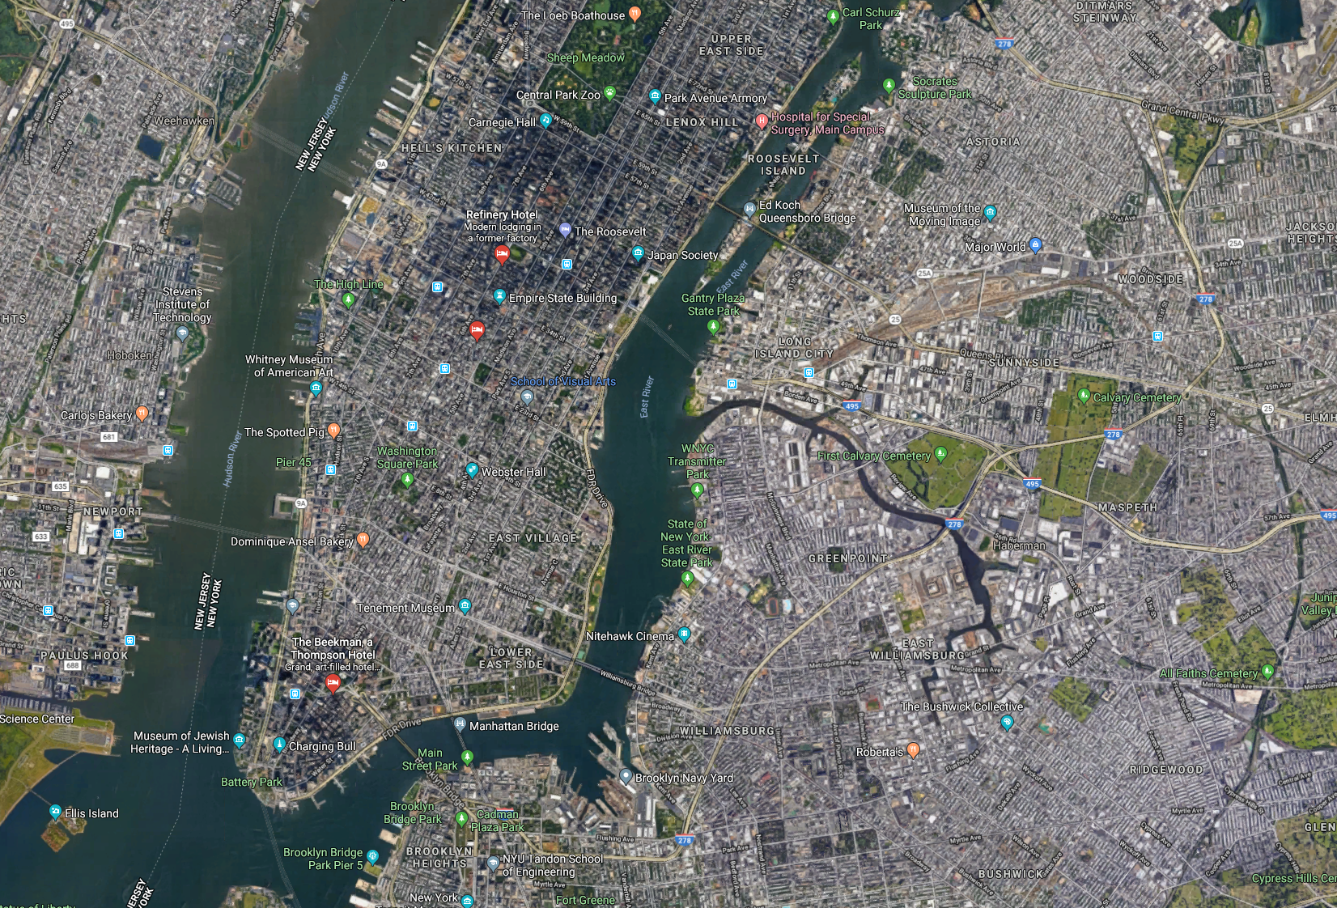
Step 4
Q: Pick a Location?

Slide 22
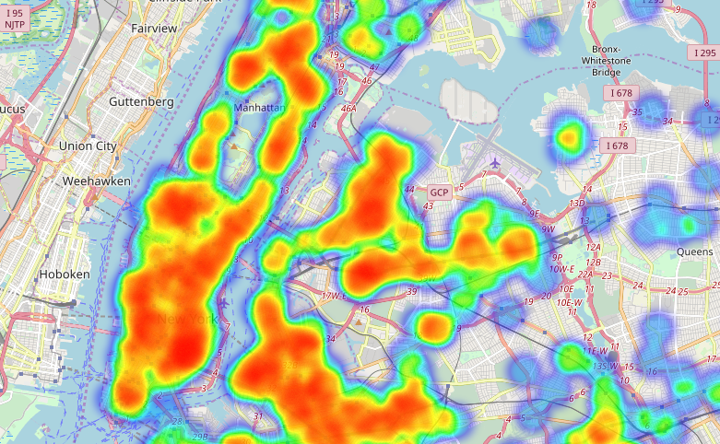
I am the Machine
We run

Slide 23
I am the Machine
We run

Slide 24
The SCORE

